Slide 1
Midwest City Stormwater Utility Fee Update
March 26, 2024

Slide 2
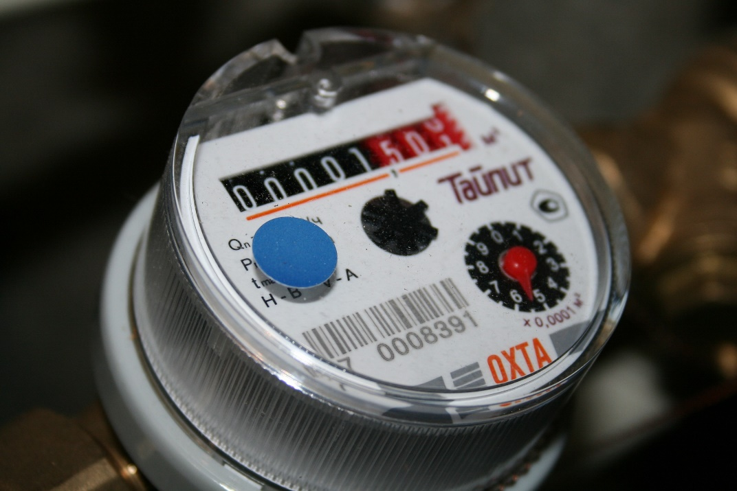
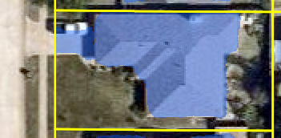
Stormwater Utility Fee Structure Options
Water Meter Type
(Current)
Impervious Area
(Proposed)
Key Factors:
Equitability
Administrative Burden

Slide 3
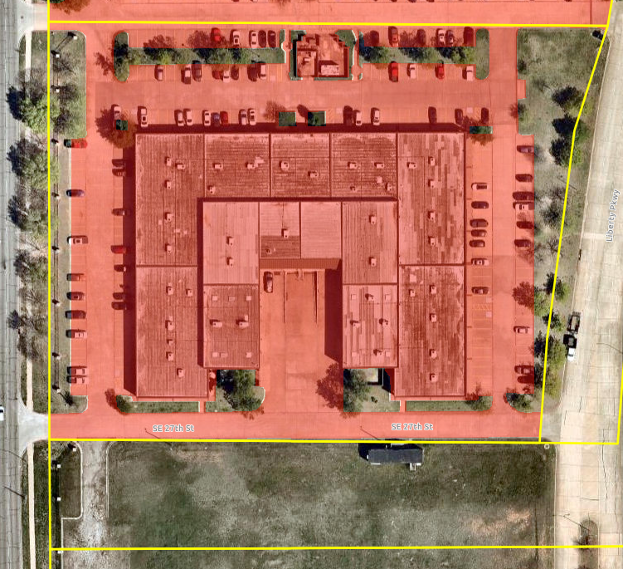
Impervious Area Analysis
Impervious Area (IA): Any hard surface that impedes water from seeping into the ground such as rooftops and pavement
Average residential property: 2,860 sq ft of IA
2,860 sq ft IA
161,808 sq ft IA

Slide 4
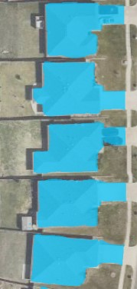
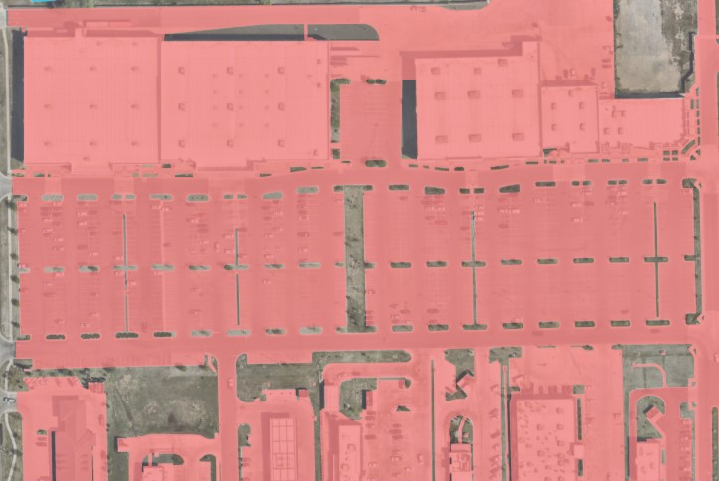
Midwest City Impervious Area Analysis
Commercial Impervious Area Example
Residential Impervious Area Example

Slide 5
Current Stormwater Utility Fee Structure
Based on water meter size – Last updated in 2008
Current Annual Revenue: $773,000
Meter Size | Rate
5/8" meter | $2.42
1" meter | $4.17
1 1/2" meter | $5.87
2" meter | $7.86
3" meter | $10.81
4" meter | $14.20
6" meter | $20.86
Mobile home parks | $2.42 per occupied pad
Apartments | $1.20 per unit

Slide 6
Proposed Stormwater Utility Fee Structure
ESU = Equivalent Service Unit
1 ESU = 2,860 sq ft IA
# of ESUs per parcel = (sq ft IA/2,860 sf)
Residential Rate = 1 ESU = Flat rate of $2.42
Commercial Rate = # of ESUs x $2.42
Calculated Annual Revenue: $1.3M
# of ESUs = 1
Fee = $2.42
# of ESUs = 57
Fee = $137.94

Slide 7
Benchmark Fee Comparison
Midwest City, OK
Average SFR sq ft IA= 2,860 (1 ESU)
Residential Fee: Flat Rate $2.42
Commercial Fee: $2.42 per ESU
Sample Property Calculation
Residential Property, 2,860 sq ft IA
Fee: $2.42
Commercial Property, 5,000 sq ft IA
Fee: $4.84
Fee is used to fund stormwater quality management not infrastructure maintenance
Edmond, OK
Average SFR sq ft IA= 4,860 (1 ESU)
Residential Fee: Flat Rate $3.00
Commercial Fee: $3.00 per ESU
Sample Property Calculation
Residential Property, 2,860 sq ft IA
Fee: $3.00
Commercial Property, 5,000 sq ft IA
Fee: $6.00
Fee is used to fund stormwater quality and floodplain management not infrastructure maintenance

Slide 8
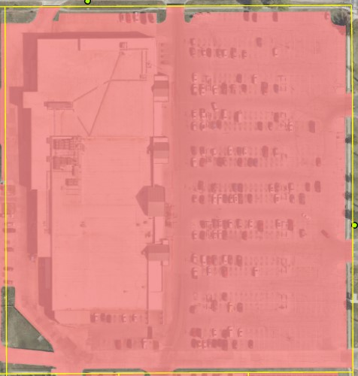
Example 1
Current
Monthly Fee
Proposed
Monthly Fee
Meter Size | Billed Amount
2” | $7.86
ESUs | Billed Amount
127 | $307.34
Benchmark City | Stormwater Fee | Total ESU | Billed Amount
Edmond | 1 ESU = 4,680 sq ft = $3.00 | 78 | $234.00
Broken Arrow | 1 ESU = 2,600 sq ft = $8.89 | 139 | $1,235.71
Tulsa | 1 ESU = 2,650 sq ft = $10.63 | 137 | $1,456.31
*Based on 360,598 sf of IA
Note: Broken Arrow and Tulsa’s fees fund stormwater quality, floodplain management, and infrastructure maintenance

Slide 9
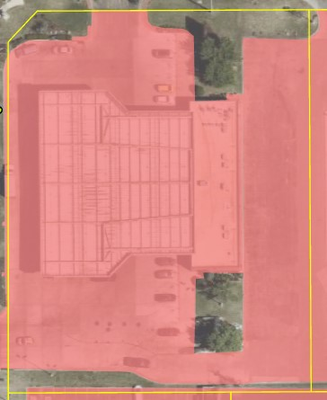
Example 2
Current
Monthly Fee
Proposed
Monthly Fee
Meter Size | Billed Amount
2” | $7.86
ESUs | Billed Amount
18 | $43.56
Benchmark City | Stormwater Fee | Total ESU | Billed Amount
Edmond | 1 ESU = 4,680 sq ft = $3.00 | 11 | $33.00
Broken Arrow | 1 ESU = 2,600 sq ft = $8.89 | 20 | $177.80
Tulsa | 1 ESU = 2,650 sq ft = $10.63 | 19 | $201.97
*Based on 50,015 sf of IA

Slide 10
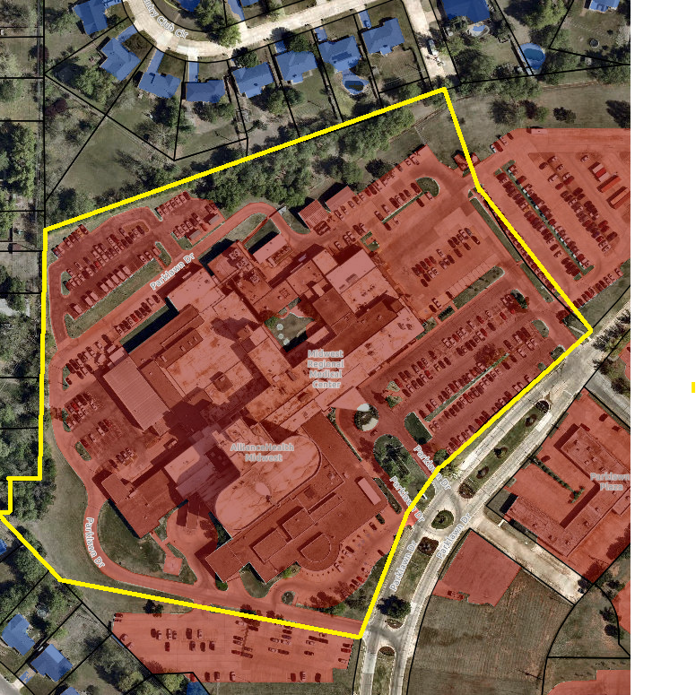
Example 3
Current
Monthly Fee
Proposed
Monthly Fee
Meter Size | Billed Amount
6” | $ 20.86
ESUs | Billed Amount
220 | $532.40
Benchmark City | Stormwater Fee | Total ESU | Billed Amount
Edmond | 1 ESU = 4,680 sq ft = $3.00 | 135 | $432.00
Broken Arrow | 1 ESU = 2,600 sq ft = $8.89 | 242 | $2,151.38
Tulsa | 1 ESU = 2,650 sq ft = $10.63 | 238 | $2,529.94
*Based on 628,316 sf of IA

Slide 11
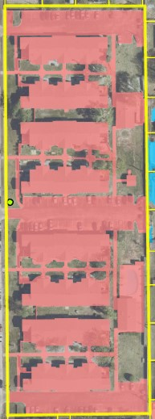
Example 4
Current
Monthly Fee
Proposed
Monthly Fee
Current Rate | Billed Amount
$1.20 (Per Unit) X 96 (Total Units) | $ 115.20
ESUs | Billed Amount
44 | $ 106.48
Benchmark City | Stormwater Fee | Total ESU | Billed Amount
Edmond | 1 ESU = 4,680 sq ft = $3.00 | 27 | $81.00
Broken Arrow | 1 ESU = 2,600 sq ft = $8.89 | 48 | $426.72
Tulsa | 1 ESU = 2,650 sq ft = $10.63 | 47 | $499.61
*Based on 123,731 sf of IA

Slide 12
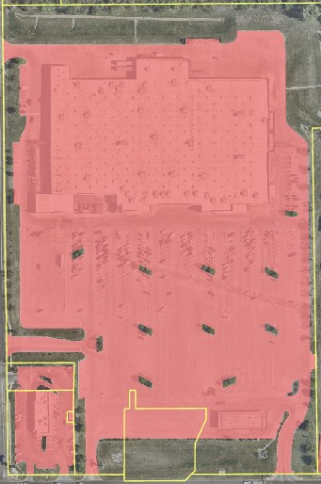
Example 5
Current
Monthly Fee
Proposed
Monthly Fee
Meter Size | Billed Amount
2” | $ 7.86
ESUs | Billed Amount
280 | $677.60
Benchmark City | Stormwater Fee | Total ESU | Billed Amount
Edmond | 1 ESU = 4,680 sq ft = $3.00 | 171 | $513.00
Broken Arrow | 1 ESU = 2,600 sq ft = $8.89 | 308 | $2,738.12
Tulsa | 1 ESU = 2,650 sq ft = $10.63 | 302 | $3,210.26
*Based on 799,082 sf of IA

Slide 13
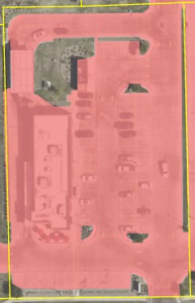
Example 6
Current
Monthly Fee
Proposed
Monthly Fee
Meter Size | Billed Amount
2” | $ 7.86
ESUs | Billed Amount
19 | $45.98
Benchmark City | Stormwater Fee | Total ESU | Billed Amount
Edmond | 1 ESU = 4,680 sq ft = $3.00 | 12 | $36.00
Broken Arrow | 1 ESU = 2,600 sq ft = $8.89 | 21 | $186.69
Tulsa | 1 ESU = 2,650 sq ft = $10.63 | 21 | $223.23
*Based on 53,558 sf of IA

Slide 14
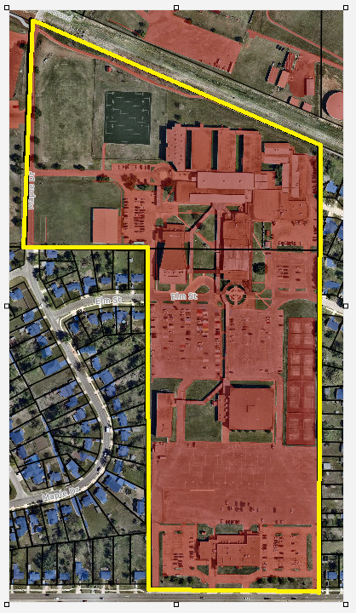
Example 7
Current
Monthly Fee
Proposed
Monthly Fee
Qty | Meter Size | Billed Amount
5 | 2” | $39.30
1 | 3” | $10.81
 | Total | $50.11
ESUs | Billed Amount
334 | $808.28
Benchmark City | Stormwater Fee | Total ESU | Billed Amount
Edmond | 1 ESU = 4,680 sq ft = $3.00 | 205 | $615.00
Broken Arrow | 1 ESU = 2,600 sq ft = $8.89 | 368 | $3,271.52
Tulsa | 1 ESU = 2,650 sq ft = $10.63 | 361 | $3,837.43
*Based on 955,240 sf of IA

Slide 15
Example 8
Current
Monthly Fee
Meter Size | Billed Amount
1” | $4.17
Proposed
Monthly Fee
Benchmark City | Stormwater Fee | Total ESU | Billed Amount
Edmond | 1 ESU = 4,680 sq ft = $3.00 | 10 | $30.00
Broken Arrow | 1 ESU = 2,600 sq ft = $8.89 | 17 | $151.13
Tulsa | 1 ESU = 2,650 sq ft = $10.63 | 17 | $180.71
ESUs | Billed Amount
15 | $36.30
*Based on 40,927 sf of IA

Slide 16
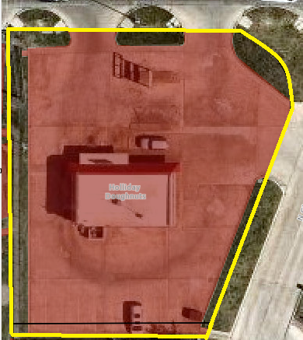
Example 9
Current
Monthly Fee
Proposed
Monthly Fee
Meter Size | Billed Amount
5/8” | $2.42
ESUs | Billed Amount
6 | $14.52
Benchmark City | Stormwater Fee | Total ESU | Billed Amount
Edmond | 1 ESU = 4,680 sq ft = $3.00 | 4 | $12.00
Broken Arrow | 1 ESU = 2,600 sq ft = $8.89 | 7 | $62.23
Tulsa | 1 ESU = 2,650 sq ft = $10.63 | 7 | $74.41
*Based on 17,035 sf of IA

Slide 17
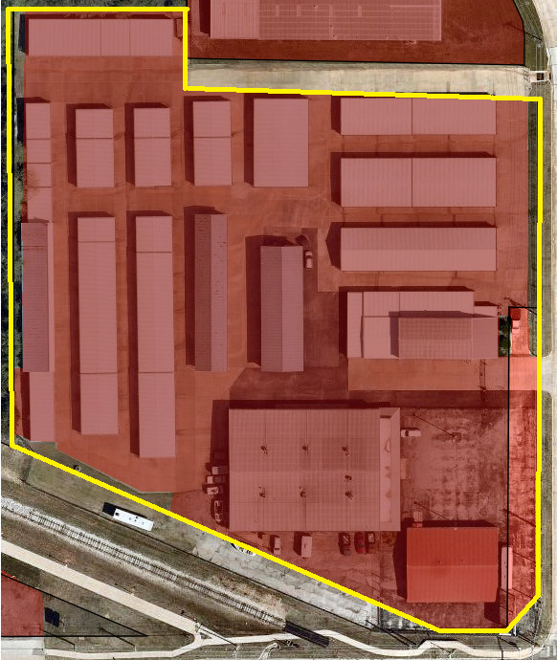
Example 10
Current
Monthly Fee
Proposed
Monthly Fee
Meter Size | Billed Amount
5/8” | $2.42
ESUs | Billed Amount
61 | $147.62
Benchmark City | Stormwater Fee | Total ESU | Billed Amount
Edmond | 1 ESU = 4,680 sq ft = $3.00 | 37 | $111.00
Broken Arrow | 1 ESU = 2,600 sq ft = $8.89 | 66 | $586.74
Tulsa | 1 ESU = 2,650 sq ft = $10.63 | 65 | $690.95
*Based on 171,847 sf of IA

